Slide 1




Parallel Processing with MapReduce in Big Data System
Presented by Qian Mai
CSCI 5551
Parallel and Distributed Systems

Slide 2

Outline
Overview
Implementation
Running
Analysis
Conclusion
Notes:
The definition of Big Data
Big data structures
Big data sources
Samples of Big data
Growing trend of Big Data
Big Data Research Fields
Benefits of Big Data
Definition of Big Data
Two Key Components of Hadoop
Hadoop Distributed File System (HDFS) Architecture
Hadoop Distributed File System (HDFS) Data Flow
Hadoop Mapreduce
Advantage of Hadoop
The impact of Hadoop

Slide 3


1. Overview
Big Data is popular and maybe as important to business and society in many aspects.
MapReduce is a prominent parallel data processing tool and it is gaining significant momentum from both industry and academia
MapReduce performance is highly related to Big Data system environment
Notes:
Big Data is popular and maybe as important to business and society in many aspects- as the Internet has become an indispensable part of our daily life. MapReduce is known for a prominent parallel data processing tool and is gaining significant momentum from both industry and academia as the volume of data to analyze grows rapidly. As is known to all, MapReduce performance is highly related to Big Data system environment, for example, the number of nodes in Hadoop, some configuration such as Shuffle, Combiner class.

Slide 4

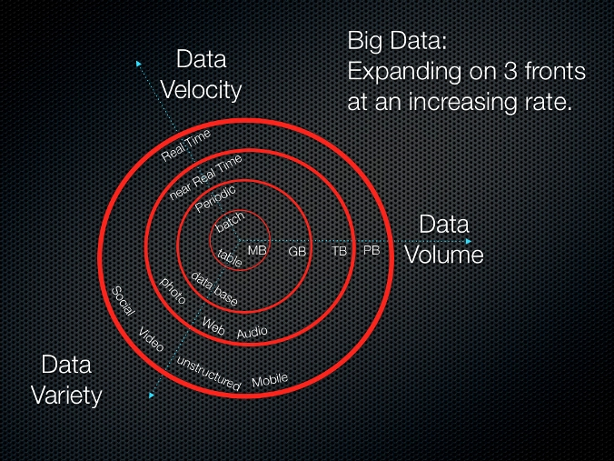
1. Overview
Big Data
Big data is a term used to describe the exponential growth and availability of data, both structured and unstructured.

Slide 5
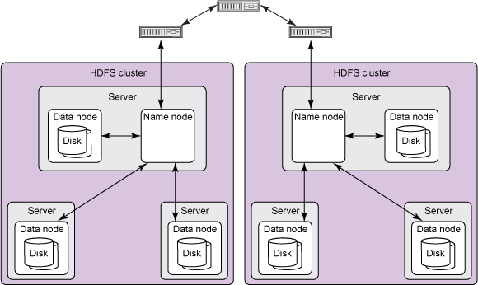
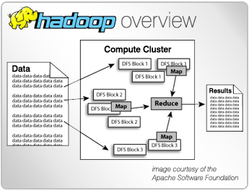
1. Overview
Hadoop
Apache Hadoop is open source, and pioneered a fundamentally new way of storing and processing data.
1. Distributed File System
2. MapReduce Engine
Notes:
1. Distributed File System
Distributed File System provides high boundary storage
2. MapReduce Engine
MapReduce is data processing frame work

Slide 6
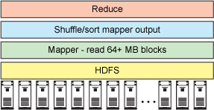
1. Overview
Hadoop
Apache Hadoop is open source, and pioneered a fundamentally new way of storing and processing data.
Hadoop architecture

Slide 7
1. Overview
Hadoop Supporting Projects
Hadoop Streaming: a utility to enable other language code
Hive and Hue: Hue gives a browser-based graphical interface to do Hive work
Pig: a higher-level programming environment
Sqoop: provides data transfer between Hadoop and DB
Oozie: manages Hadoop workflow
Hbase: a super-scalable key-value store
FlumeNG: a real time loader for streaming data into Hadoop
Whirr: cloud provisioning for Hadoop
Mahout: machine learning for Hadoop
Fuse: makes the HDFS system look like a regular file system
Zookeeper: manage synchronization for the cluster
Notes:
Hadoop Streaming: A utility to enable MapReduce code in any language: C, Perl, Python, C++, Bash, etc.
Hive and Hue: get 4000 notes and multi-Petabyte scalability. Hue gives a browser-based graphical interface to do your Hive work.
Pig: A higher-level programming environment to do MapReduce coding which provides incredible price-performance and high availability.
Sqoop: Provides bi-directional data transfer between Hadoop and your favorite relational database.
Oozie: Manages Hadoop workflow. It provide if-then-else branching and control within your Hadoop jobs.
Hbase: A super-scalable key-value store. It works very much like a persistent hash-map.
FlumeNG: A real time loader for streaming your data into Hadoop. It stores data in HDFS and HBase.
Whirr: Cloud provisioning for Hadoop. You can start up a cluster in just a few minutes with a very short configuration file.
Mahout: Machine learning for Hadoop. Used for predictive analytics and other advanced analysis.
Fuse: Makes the HDFS system look like a regular file system so you can use ls, rm, cd, and others on HDFS data.
Zookeeper: Used to manage synchronization for the cluster.

Slide 8
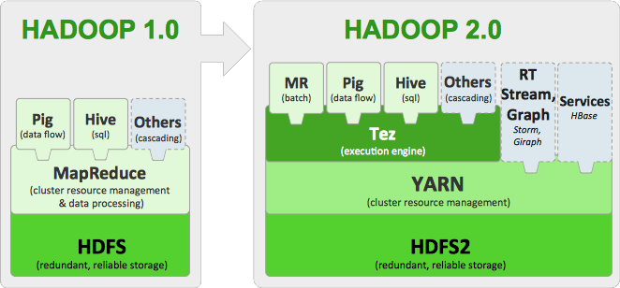
1. Overview
Hadoop Supporting Projects cont’d

Slide 9
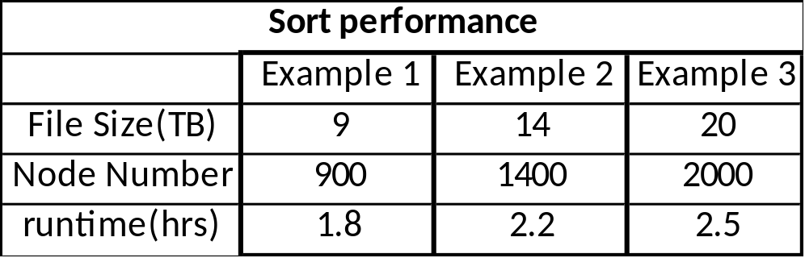
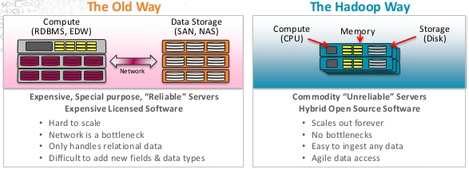
1. Overview
How well does Hadoop scale?
Hadoop has been demonstrated on clusters of up to 4000 nodes.
Sort performance on 900 nodes is good (sorting 9TB of data on 900 nodes takes around 1.8 hours)

Slide 10
1. Overview
What is the cost of distribution?
The HDFS reading performance is much lower than the local File System for the small data set, because each node on the testing cluster has 1 GB Ram and the small data set (512 MB) is fit within the Ram.
HDFS is designed for huge data sets, so for the small data set the HDFS writing/reading performance is lower than the local File System .
HDFS is a distributed file system above all over local file system on each node because of the HDFS management and maybe Java IO overhead.

Slide 11
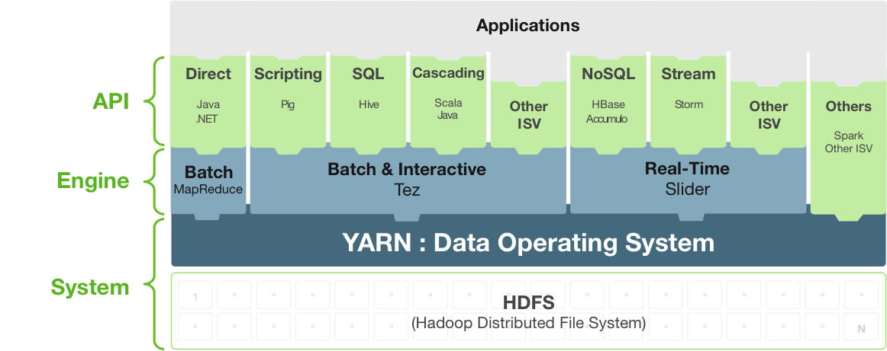
1. Overview
The applications that Hadoop works well for

Slide 12
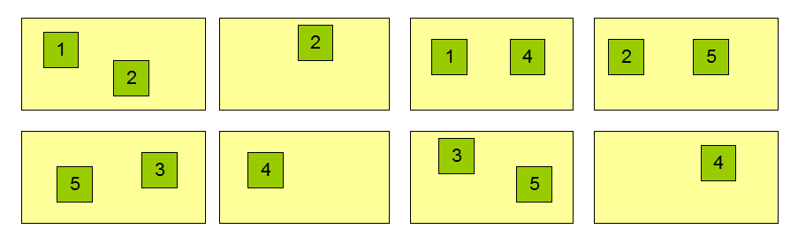
1. Overview
Data Replication
Block Replication
Namenode (Filename, numReplicas, block-ids, …)
/users/sameerp/data/part-0, r:2, {1,3}, …
/users/sameerp/data/part-1, r:3, {2,4,5}, …
Datanodes
Notes:
The NameNode makes all decisions regarding replication of blocks. It periodically receives a Heartbeat and a Blockreport from each of the DataNodes in the cluster. Receipt of a Heartbeat implies that the DataNode is functioning properly. A Blockreport contains a list of all blocks on a DataNode.

Slide 13
1. Overview
Advantages of Hadoop
Disadvantages of Hadoop
Scalable
Cost Effective
Flexible
Fast
Resilient to Failure
Security Concerns
Vulnerable By Nature
Not Fit for Small Data
General Limitations
Notes:
1. Security Concerns
Just managing a complex application such as Hadoop can be challenging. A classic example can be seen in the Hadoop security model, which is disabled by default due to sheer complexity. If whoever’s managing the platform lacks the knowhow to enable it, your data could be at huge risk. Hadoop is also missing encryption at the storage and network levels, which is a major selling point for government agencies and others that prefer to keep their data under wraps.
2. Vulnerable By Nature
Speaking of security, the very makeup of Hadoop makes running it a risky proposition. The framework is written almost entirely in Java, one of the most widely used yet controversial programming languages in existence. Java has been heavily exploited by cybercriminals and as a result, implicated in numerous security breaches. For this reason, several experts have suggested dumping it in favor of safer, more efficient alternatives.
3. Not Fit for Small Data
While big data isn’t exclusively made for big businesses, not all big data platforms are suited for small data needs. Unfortunately, Hadoop happens to be one of them. Due to its high capacity design, the Hadoop Distributed File System or HDFS, lacks the ability to efficiently support the random reading of small files. As a result, it is not recommended for organizations with small quantities of data.
4. Potential Stability Issues
Hadoop is an open source platform. That essentially means it is created by the contributions of the many developers who continue to work on the project. While improvements are constantly being made,
like all open source software, Hadoop has had its fair share of stability issues. To avoid these issues, organizations are strongly recommended to make sure they are running the latest stable version, or run it under a third-party vendor equipped to handle such problems.
5. General Limitations
One of the most interesting highlights of the Google article referenced earlier mentions that when it comes to making the most of big data, Hadoop may not be the only answer. The article introducesApache Flume, MillWheel, and Google’s own Cloud Dataflow as possible solutions. What each of these platforms have in common is the ability to improve the efficiency and reliability of data collection, aggregation, and integration. The main point the article stresses is that companies could be missing out on big benefits by using Hadoop alone.

Slide 14
1. Overview
Hadoop’s limitations for big data analysis
Multiple copies of already big data
Very limited SQL support
Inefficient execution
Challenging framework
Lack of required skills
Notes:
Lack of required skills

Slide 15

1. Overview
Division of team work
Hadoop system installation (Bogki)
Source data collection (Bogki)
MapReduce program coding (Me)
MapReduce program running(Me)
Evaluation and conclusion (Me)

Slide 16
2. Implementation
Install Big Data System (Hadoop) in Linux
Collecting Source Data (3.1GB) at Amazon S3
Making MapReduce programming (in Java) for analyzing the Big Data
Execute the MapReduce Program on different nodes (single, 2, 3, 4)
Making sequential file reading programming (in Java) for comparison
Notes:
To realize above goal, we will set a Big Data system on Hydra and experiment MapReduce program with 100GB data at a various nodes, single, 2, 4, 8, and 16. To implement it and evaluate the results, we will follow as:

Slide 17
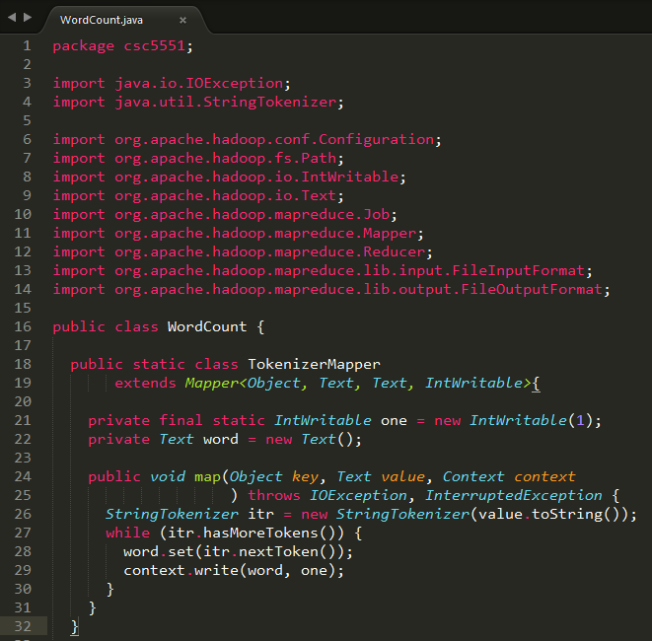
3. Hadoop Coding Part1

Slide 18
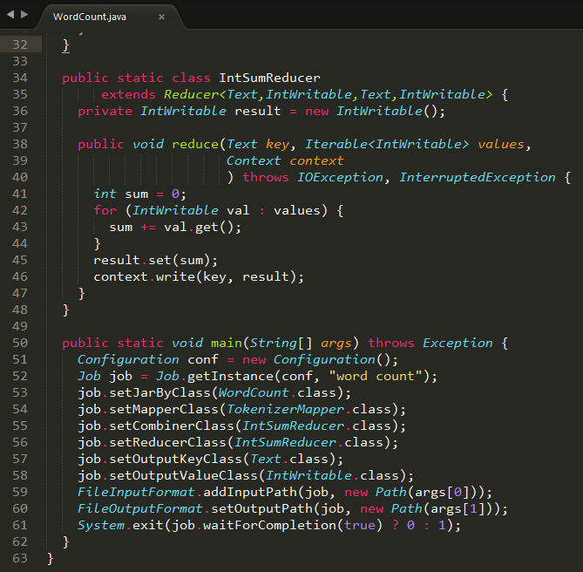
3. Hadoop Coding Part2

Slide 19
3. Coding (WordCount Excution Process)
1. Split
Input data
Split result
Hello World
Bye World
<0, “Hello World” >
<12, “Bye World” >
split
Hello Hadoop
Bye Hadoop
<0, “Hello Hadoop” >
<13, “Bye Hadoop” >
split

Slide 20
3. Coding (WordCount Excution Process)
2. Map()
Split result
Map() output
<0, “Hello World” >
<12, “Bye World” >
<Hello, 1>
<World, 1>
<Bye, 1>
<World, 1>
Map()
<0, “Hello Hadoop” >
<13, “Bye Hadoop” >
<Hello, 1>
<Hadoop, 1>
<Bye, 1>
< Hadoop, 1>
Map()

Slide 21
3. Coding (WordCount Excution Process)
3. Sort and Combine
Map() output
sort result
Combine output
<Hello, 1>
<World, 1>
<Bye, 1>
<World, 1>
<Bye, 1>
<Hello, 1>
<World, 1>
<World, 1>
<Bye, 1>
<Hello, 1>
<World, 2>
sort
Combine
<Hello, 1>
<Hadoop, 1>
<Bye, 1>
< Hadoop, 1>
<Bye, 1>
<Hadoop, 1>
< Hadoop, 1>
<Hello, 1>
<Bye, 1>
< Hadoop, 2>
<Hello, 1>
sort
Combine

Slide 22
3. Coding (WordCount Excution Process)
4. Reduce()
Combine output
sort result
Reduce output
<Bye, 1>
<Hello, 1>
<World, 2>
<Bye, list(1,1)>
<Hadoop, list(2)>
< Hello, list(1,1)>
<World, list(2)>
<Bye, 2>
<Hadoop, 2>
< Hello, 2>
<World, 2>
sort
Reduce()
<Bye, 1>
< Hadoop, 2>
<Hello, 1>

Slide 23
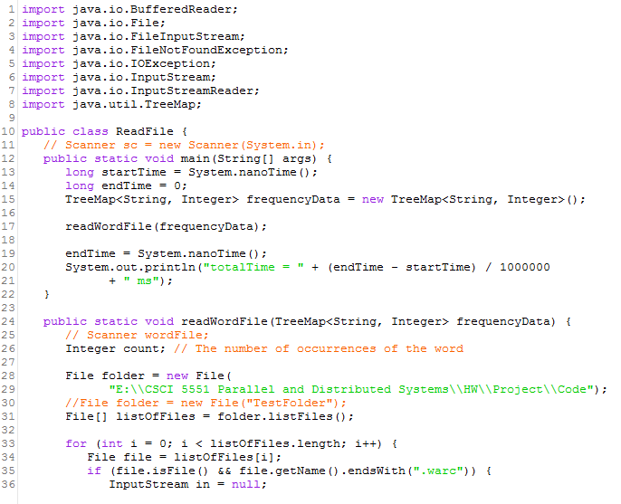
3. Sequential Coding Part1

Slide 24
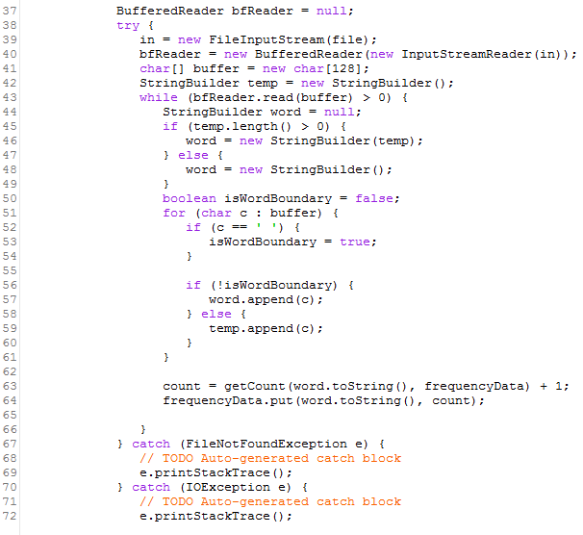
3. Sequential Coding Part2

Slide 25
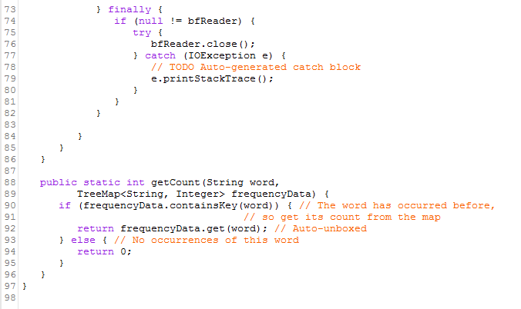
3. Sequential Coding Part2
ReadFile.java
totalTime = 347042 ms

Slide 26
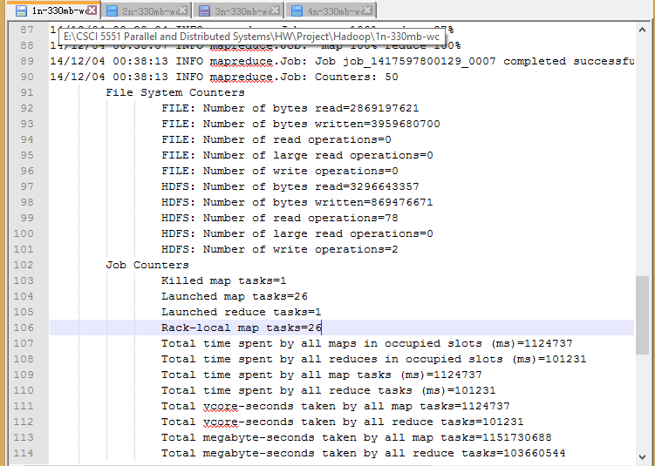
3. Result 1 node
1n-330mb-wc.txt

Slide 27
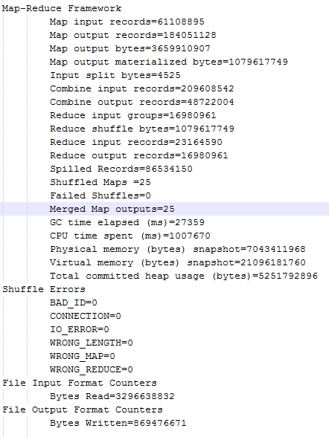
3. Result 1 node cont’d

Slide 28
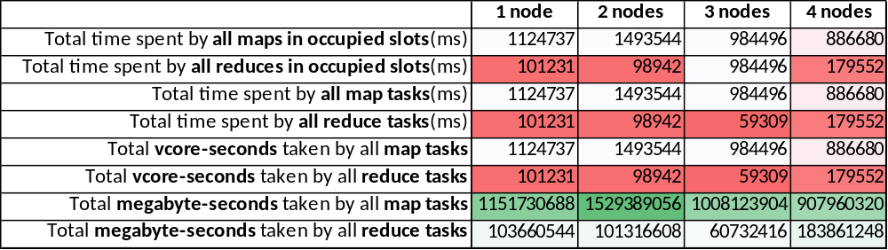
4. Analysis
Job Counters Data Collection
Notes:
Vcore determines how much voltage the CPU gets

Slide 29
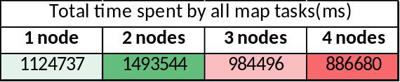
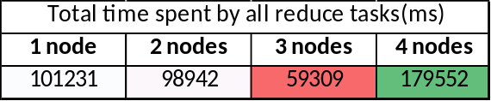
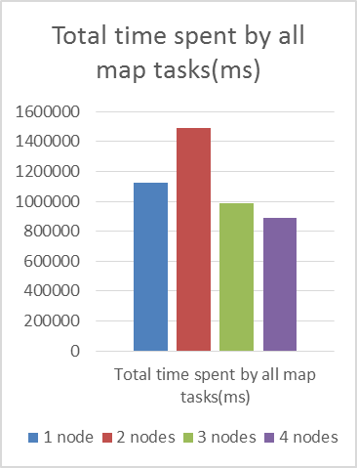
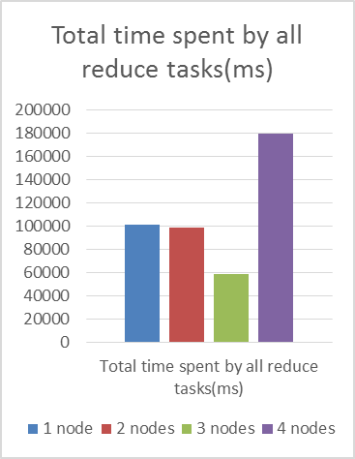
4. Analysis
Job Counters Data Chart

Slide 30
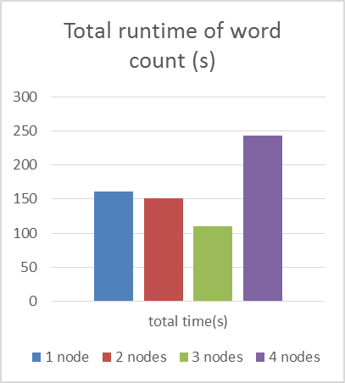
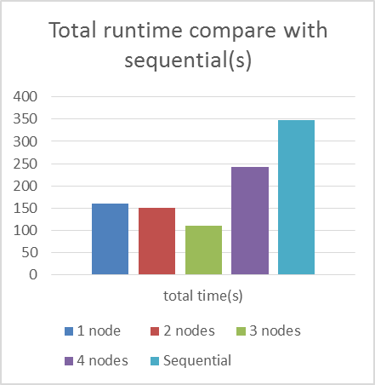
4. Analysis
Total runtime of word count

Slide 31
4. Conclusion
Hadoop allows writing/reading parallely on all data nodes like other distributed file system.
2. MapReduce perform parallel operations both in Map() and Reduce() depending on user’s purposes. Compared with sequential wordcount, MapReduce wordcount has better runtime in single node as well as multiple nodes.
3. While using parallel methods for Big Data, it needs a lot of resources to big data processing. It needs to observe the MapReduce application for tuning, where bottleneck happens.

Slide 32
4. Conclusion
Future Work
Our future work is tuning the MapReduce applications with deep understanding. And while using a lot of eco-system, we’ll compare which is better, and finally we will compare the performance between MapReduce and No-MR.

Slide 33
References
[1] Kyong-Ha Lee, Yoon-Joon Lee, Hyunsik Choi, Yon Dohn Chung, Bongki Moon, “Parallel Data Processing with MapReduce: A Survey”, In SIGMOD Record, December 2011 (Vol. 40, No. 4)
[2] Konstantin Shvachko, Hairong Kuang, Sanjay Radia, Robert Chansler, “The Hadoop Distributed File System”, In Proc, IEEE 2010,
[3] MapReduce Wikipedia, http://en.wikipedia.org/wiki/MapReduce
[4] J. Dean, S. Ghemawat, “MapReduce: Simplified Data Processing on Large Clusters,” In Proc. of the 6th Symposium on Operating Systems Design and Implementation, San Francisco CA, Dec. 2004.
[5] Amazon Public data sets, common crawl corpus, http://aws.amazon.com/datasets/41740
[6] Apache Hadoop, http://hadoop.apapche.org
[7] The Hadoop Distributed File System: Architecture and Design,
https://hadoop.apache.org/docs/r0.18.0/hdfs_design.pdf
[8] S. Huang, J. Huang, J. Dai, T. Xie, B. Huang, “The HiBench Benchmark suite: Characterization of the Mapreduce-Based Data Analysis”, In Proc. of IEEE 26th International Conference on Data Engineering Workshops, 2010

Slide 34



Slide 35


